Slide 1
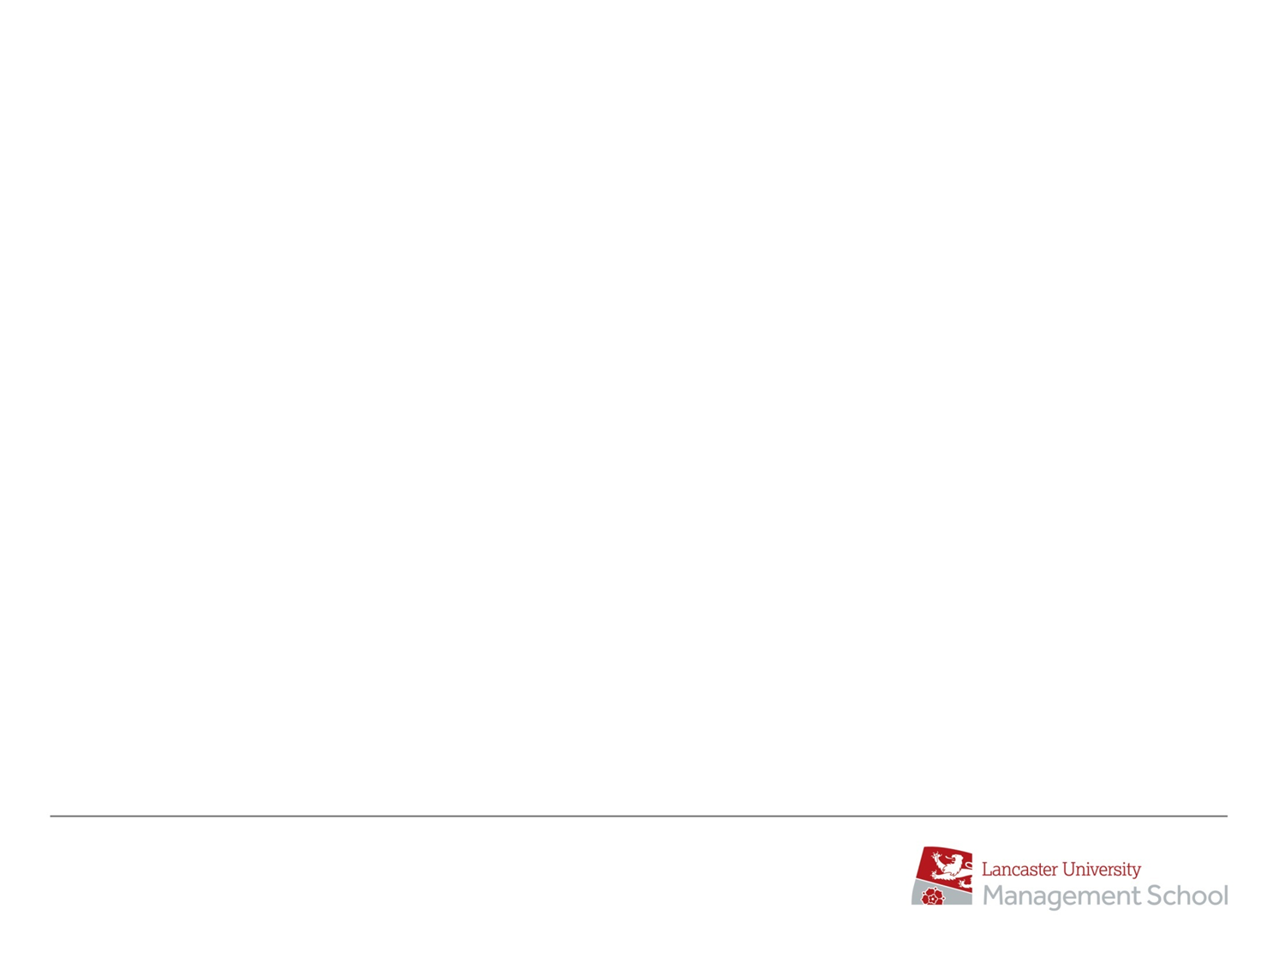
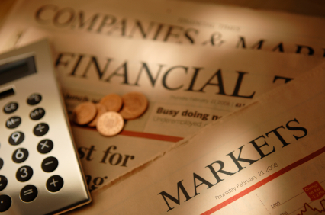

AcF 304 Financial Markets Topic 5 – The Foreign Exchange Market
Part 5 – FX Forwards & Swaps
Notes:
If this PowerPoint presentation contains mathematical equations, you may need to check that your computer has the following installed:
1) MathType Plugin
2) Math Player (free versions available)
3) NVDA Reader (free versions available)

Slide 2
FORWARDS
Definition: Forward contracts stipulate the number and price (in HC) of FC units that are bought and sold (until here: like spot contracts) at some point in the future (unlike spot: not 2 days from now)
A contract set up at t for delivery/payment at T is denoted by ^{F}t,T
Forward contracts represent a binding obligation and participants cannot walk away
Forward contracts are over-the-counter products – similar to the currency contracts we trade in spot markets
Notes:
Forward Outrights are mainly quoted by Banks to non-bank customers.
Corporate clients have a large demand for Outrights in order to finance trade and to hedge their foreign currency exposure.

Slide 3
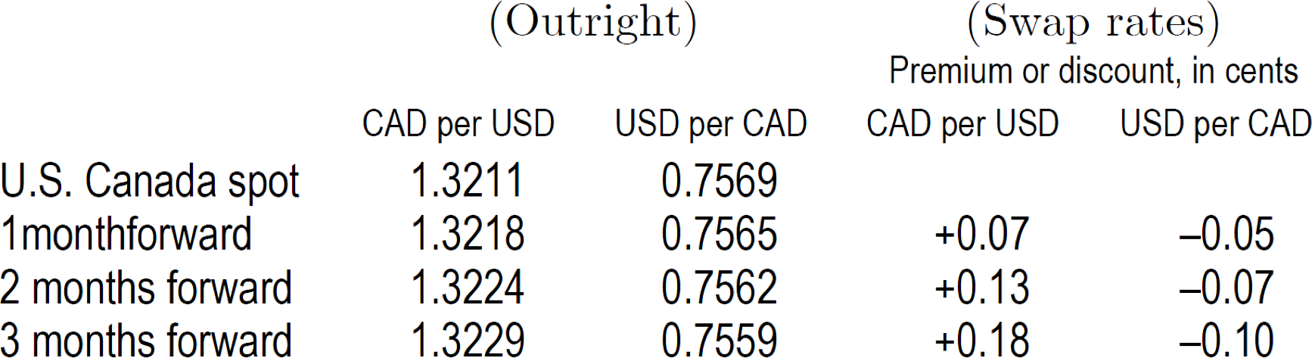
FORWARDS
Origin of the term “swap rate” is the swap contract:
− Buy an asset now (at the spot rate) and sell it in the future (at the forward rate) to facilitate a portfolio investment in a foreign country.
− Swap rate: Undiscounted profit from this strategy (sell − buy price).
More terminology:
− If swap > 0, then FC trades at a premium (in the example: the U.S. dollar becomes more expensive over time).
− If swap < 0, then FC trades at a discount (in the example: the Canadian dollar
becomes cheaper over time).
3
Notes:
Forward Outrights are mainly quoted by Banks to non-bank customers.
Corporate clients have a large demand for Outrights in order to finance trade and to hedge their foreign currency exposure.

Slide 4
Origin of Swap Contracts
First well-known swap contract between IBM and World Bank (WB) in 1981; purpose: to save transaction costs
IBM wanted to replace its debt in DEM and CHF with USD debt
USD had appreciated and the DEM and CHF interest rates had also gone up
IBM would have to buy DEM and CHF currency, thus incurring transaction costs
IBM would have to pay a capital-gains tax on the difference between the (dollar) book value and the price it paid to redeem the bonds
IBM would have to issue new USD bonds to finance the redemption of its CHF and DEM debt

Slide 5
Origin of Swap Contracts
First well-known swap contract between IBM and World Bank (WB) in 1981; purpose: to save transaction costs
WB, on the other hand, wanted to borrow DEM and CHF to lend to its customers
IBM issuing new CHF and DEM bonds would have entailed issuing costs
Using a swap contract:
WB would borrow USD, converts proceedings into DEM/CHF and uses them to make loans to their customers
WB then pays IBM’s DEM/CHF debt obligations, while IBM pays WB’s USD debt obligations → save transaction costs, defer taxes

Slide 6

FX Swap
Two trades take place, one on the near date (first leg, usually spot), the second on the far date (second leg)
The second leg is the reverse of the first e.g.
Sell USD v JPY for Spot USD 10 MM
Buy USD v JPY for 1-month times
Normally the Base currency amounts are identical and the Quoted currency amounts differs between the two legs
Notes:
Note:
More and more often nowadays the second leg is not an exact reversal of the first leg.
Banks are quite likely to trade for Split Amounts.
In this situation the quantity of Base currency dealt on the second leg is slightly More than the Near quantity.
This is done to minimise currency risk on the interest (actual or implicit) that relates to the principal amount.
More on Split Amounts in a few minutes

Slide 7
FX SWAP – Example
Companies may use FX Swaps to avoid foreign exchange risk.
A British Company may own / be long EUR from sales in Europe but operate primarily in Britain using GBP.
However, they know that they need to pay their manufacturers in Europe in 1 month.
They could spot sell their EUR and buy GBP to cover their expenses in Britain, and then in one month spot buy EUR and sell GBP to pay their business partners in Europe.
However, this exposes them to FX risk. If Britain has financial trouble and the EUR/GBP exchange rate moves against them, they may have to spend a lot more GBP to get the same amount of EUR.
Therefore, they create a 1-month swap, where they Sell EUR and Buy GBP on spot and simultaneously buy EUR and sell GBP on a 1-month (1M) forward.
This significantly reduces their risk. The company knows they will be able to purchase EUR reliably while still being able to use currency for domestic transactions in the interim
Notes:
Note:
More and more often nowadays the second leg is not an exact reversal of the first leg.
Banks are quite likely to trade for Split Amounts.
In this situation the quantity of Base currency dealt on the second leg is slightly More than the Near quantity.
This is done to minimise currency risk on the interest (actual or implicit) that relates to the principal amount.
More on Split Amounts in a few minutes

Slide 8
Broken Dates
In practice, many banks and corporates need quotes for periods intermediate between the standard run (or fixed periods i.e. not 1, 2 or 3 months!)
They want to trade for a specific date not 12 months – e.g. 10 months and 11 days.
They use a process of linear interpolation to calculate the quotes
i.e. 311/360 x 4%
Notes:
Official ACI Forward Points Calculation:
Forward Points = (B - A) x (S x T)
(A x T) + (100 x DB)
A = Base Currency Interest Rate
B = Quote Currency Interest Rate
S = Spot Rate
T = Time in Days
DB = Day Basis (360 or 365)

Slide 9
AcF 304 Financial Markets Topic 5 – The Foreign Exchange Market
Notes:
If this PowerPoint presentation contains mathematical equations, you may need to check that your computer has the following installed:
1) MathType Plugin
2) Math Player (free versions available)
3) NVDA Reader (free versions available)

